Slide 1

Carotid Plaque Characterization with Medical Ultrasound
Matthew M. McCormick
Under the supervision of Dr. Tomy Varghese
A dissertation submitted in partial fulfillment of the requirements for the degree of
Doctor of Philosophy
(Department of Biomedical Engineering)
UNIVERSITY OF WISCONSIN-MADISON
April 7, 2011

Slide 2
The Problem: Stroke
Stroke is the loss of brain function due to hypoxia.
Effects of a stroke include impaired movement, speech, cognition, or death.
Very prevalent, in the United States¹:
Leading cause of serious, long-term disability.
780,000 new cases in 2005.
Third leading cause of death.
150,000 deaths in 2004.
$43.7 billion dollars in direct medical costs in 2008.
¹American Heart Association. Heart disease and stroke statistics – 2008 update. Online.

Slide 3
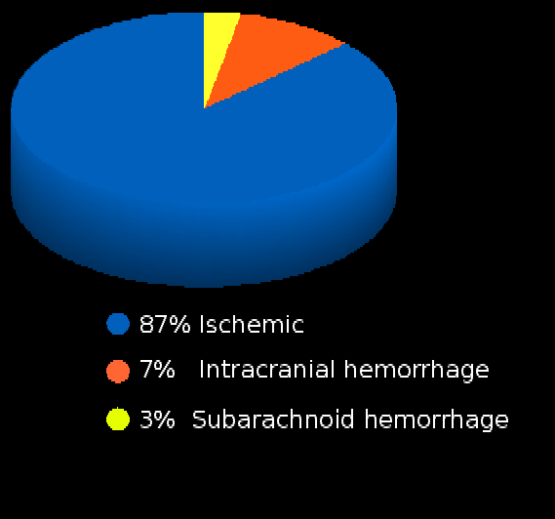
Etiology of Stroke
Stroke can be caused by subarachnoid hemorrhage or intracranial hemorrhage, but ischemic stroke is the most common.
Ischemic stroke can occur through a hemodynamic, thrombotic, or embolic mechanism.
¹American Heart Association. Heart disease and stroke statistics – 2008 update. Online.

Slide 4
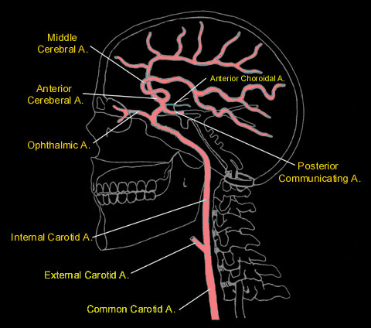
Etiology of Stroke
Emboli have many origins.
Atrial fibrillation
Congestive heart failure
Mechanical heart valve
Patent foramen ovale
Plaque fragments or thrombi originating from the carotid artery
Image source: http://www.meddean.luc.edu/lumen/MedEd/neuro/neurovasc/navigation/ica.htm

Slide 5
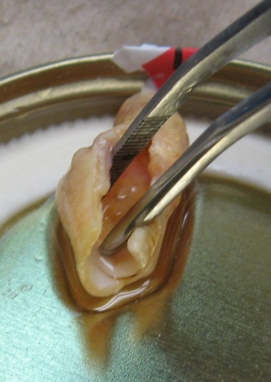
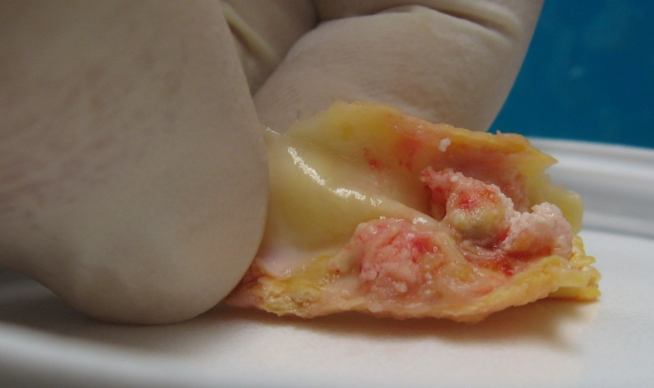
Differentiating high risk carotid plaques
Plaque accumulates in the larger arteries throughout our lives.
The carotid bifurcation is particularly susceptible to accumulation.
Although many people will accumulate plaque, only a few will develop ischemic symptoms.

Slide 6
Differentiating high risk carotid plaques
The purpose of this research:
Development of a method to identify and differentiate high risk plaque.

Slide 7
Factors that increase risk
Increased hemodynamic forces
Hypertension
Cyclic loading
Stress concentrators
Material inhomogeneity
Morphological irregularity
Ulceration
Vasa vasorum
Weak materials
Inflammation and enzymes such as matrix metalloproteinase-9.
Weak constituents such as lipid or fresh hemorrhage.

Slide 8
Factors that increase risk
Increased hemodynamic forces
Hypertension
Cyclic loading
Stress concentrators
Material inhomogeneity
Morphological irregularity
Ulceration
Vasa vasorum
Weak materials
Inflammation and enzymes such as matrix metalloproteinase-9.
Weak constituents such as lipid or fresh hemorrhage.

Slide 9
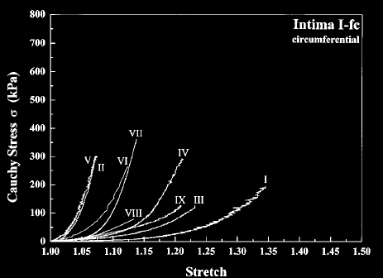
Proposed method for assessing risk
Image plaque strain.
Quantifies local compression and stretching experienced by tissue.
Measured with the spatial gradient of the tissue displacement.
Figure taken from G.A. Holzapel, G. Sommer, and P. Regitnig. Anisotropic mechanical properties of tissue components in human atherosclerotic plaques. Journal of Biomechanical Engineering – Transactions of the ASME. 126(5):657-665, 2004.

Slide 10
Proposed method for assessing Risk
Directly measures how close tissue is to failure/ rupture.
High hemodynamic forces and intense stress concentrators result in high strains.
Lipid and hemorrhage, weaker materials, also have low elastic moduli and will have high strains.
Figure taken from G.A. Holzapel, G. Sommer, and P. Regitnig. Anisotropic mechanical properties of tissue components in human atherosclerotic plaques. Journal of Biomechanical Engineering – Transactions of the ASME. 126(5):657-665, 2004.
Notes:
10

Slide 11
Specific Aims
Aim 1: Non-invasive ultrasonic carotid plaque strain imaging for stroke risk assessment.
Aim 2: In vitro ultrasonic high frequency plaque characterization.
Aim 3: Transcranial Doppler detection of microemboli.

Slide 12
Strain imaging algorithm Overview
Displacement Images
Strain Images
Cardiac Cycle Accumulation
Strain Metrics
Notes:
12

Slide 13
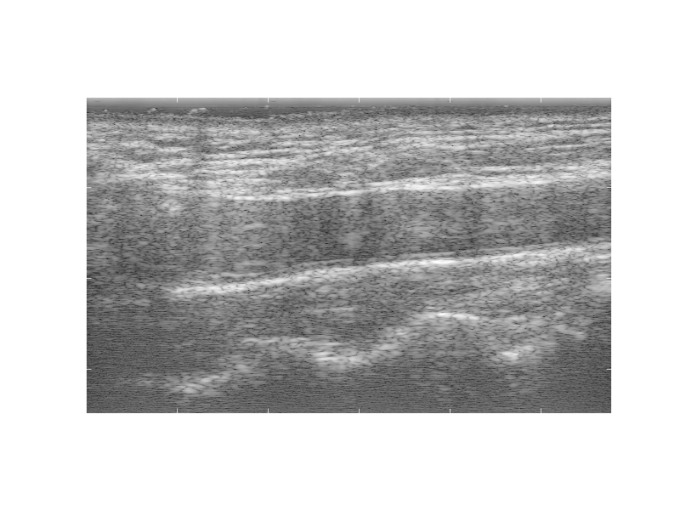
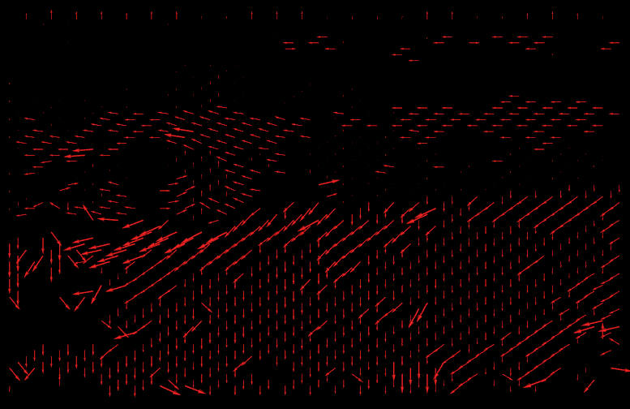

Strain imaging algorithm Block-matching motion tracking
Pre-deformation
image
Displacement field
Displacement Images
Post-deformation
image
Strain Images
Cardiac Cycle Accumulation
Strain Metrics
Notes:
13

Slide 14
Strain imaging algorithm Block-matching motion tracking
Pre-deformation
image
Displacement Images
Post-deformation
image
Strain Images
Cardiac Cycle Accumulation
Strain Metrics
Notes:
14

Slide 15
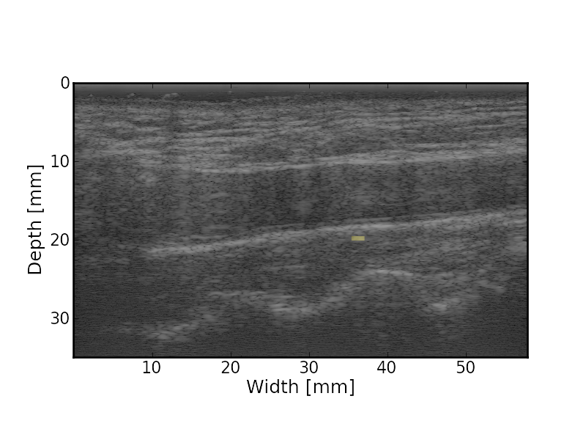
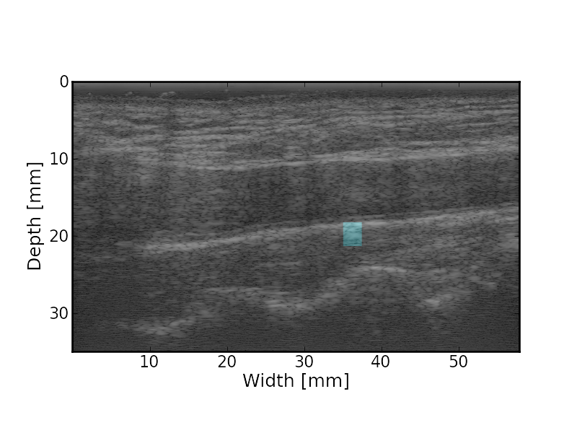
Strain imaging algorithm Block-matching motion tracking
Pre-deformation
image
Matching
Kernel
Displacement Images
Post-deformation
image
Search
Region
Strain Images
Cardiac Cycle Accumulation
Strain Metrics
Notes:
15

Slide 16
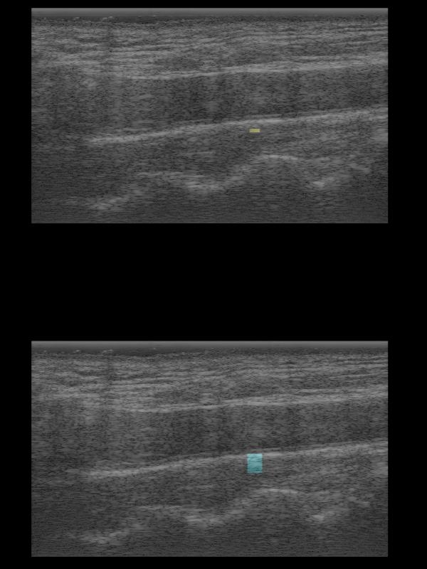
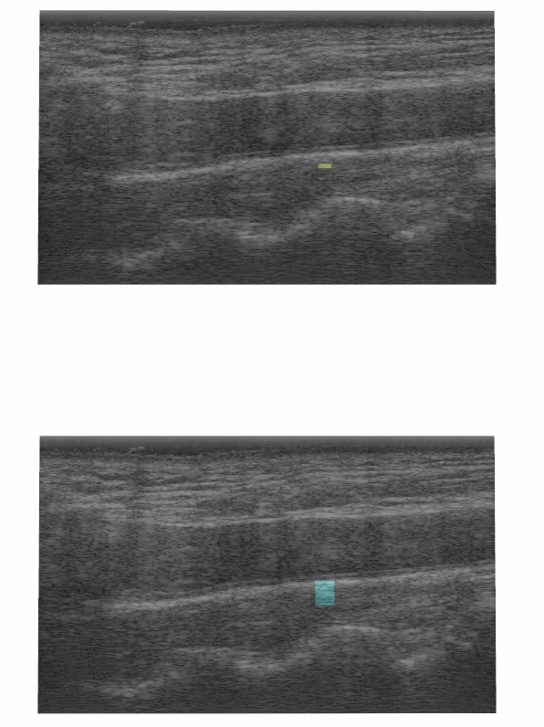
Strain imaging algorithm Block-matching motion tracking
Matching
Kernel
Displacement Images
Search
Region
Strain Images
Cardiac Cycle Accumulation
Strain Metrics
Notes:
16

Slide 17
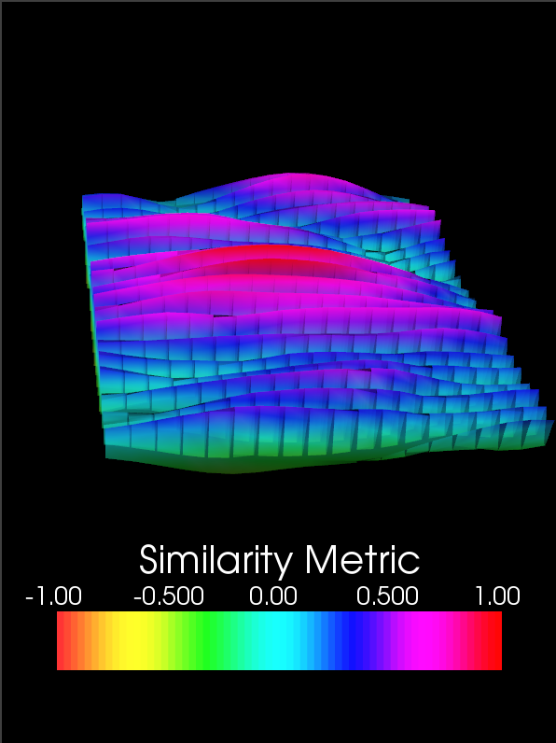
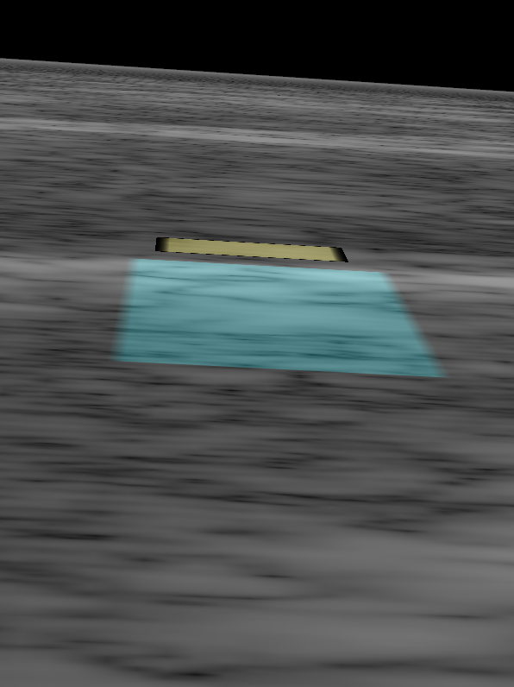
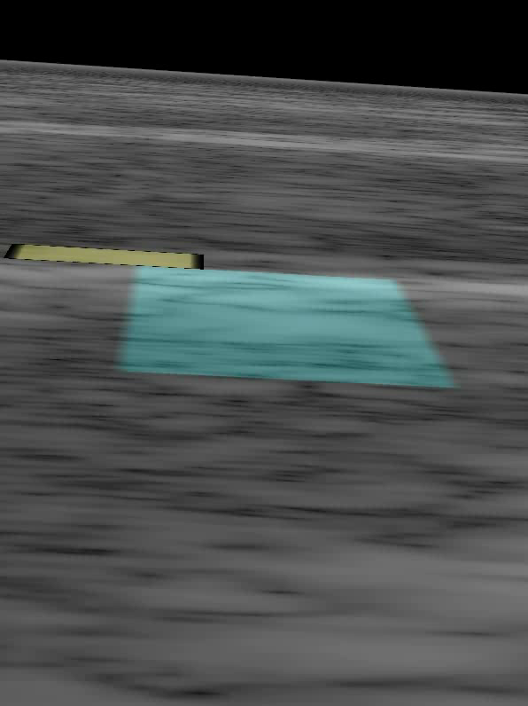
Strain imaging algorithm Block-matching motion tracking
Displacement Images
Strain Images
Cardiac Cycle Accumulation
Strain Metrics
Notes:
17

Slide 18
Strain imaging algorithm Block-matching motion tracking
Displacement Images
Strain Images
Cardiac Cycle Accumulation
Strain Metrics
Notes:
18

Slide 19
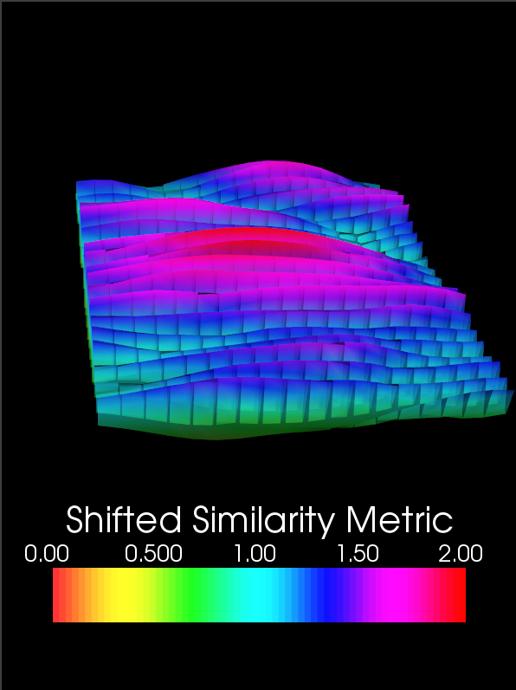
Strain imaging algorithm Noise resistance with Bayesian regularization
Shift by theoretical lower bound
Displacement Images
Strain Images
Cardiac Cycle Accumulation
Strain Metrics
Notes:
19

Slide 20
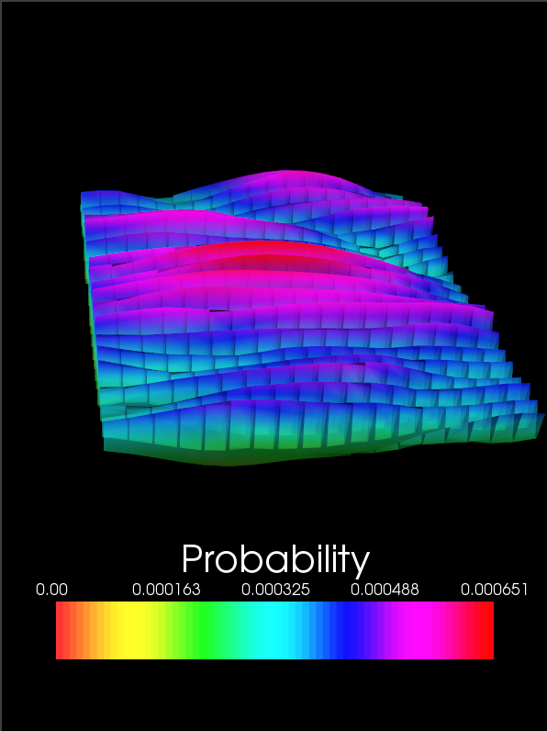
Strain imaging algorithm Block-matching motion tracking
Shift by theoretical lower bound
Normalize such that the values sum to one
Displacement Images
Strain Images
Cardiac Cycle Accumulation
Strain Metrics
Notes:
20

Slide 21
Strain imaging algorithm Block-matching motion tracking
Shift by theoretical lower bound
Normalize such that the values sum to one
Displacement Images
Strain Images
Cardiac Cycle Accumulation
Strain Metrics
Notes:
21

Slide 22



Strain imaging algorithm Noise resistance with Bayesian regularization
Recursive Bayesian Regularization
Displacement Images
Strain Images
Cardiac Cycle Accumulation
Strain Metrics
Notes:
22

Slide 23

Strain imaging algorithm Noise resistance with Bayesian regularization
Recursive Bayesian Regularization
Displacement Images
Strain Images
Cardiac Cycle Accumulation
Strain Metrics
Notes:
23

Slide 24
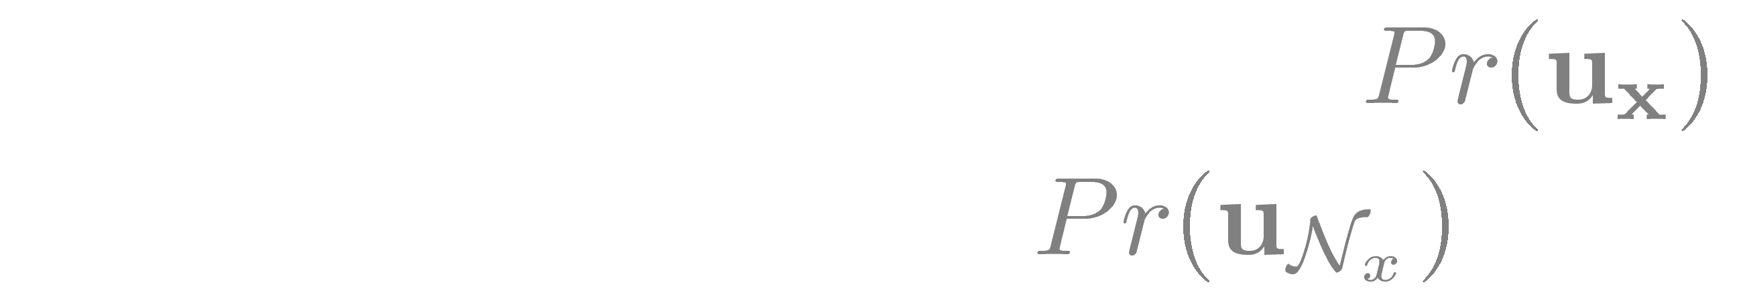
Strain imaging algorithm Noise resistance with Bayesian regularization
Recursive Bayesian Regularization
Displacement Images
Strain Images
Cardiac Cycle Accumulation
Strain Metrics
Notes:
24

Slide 25
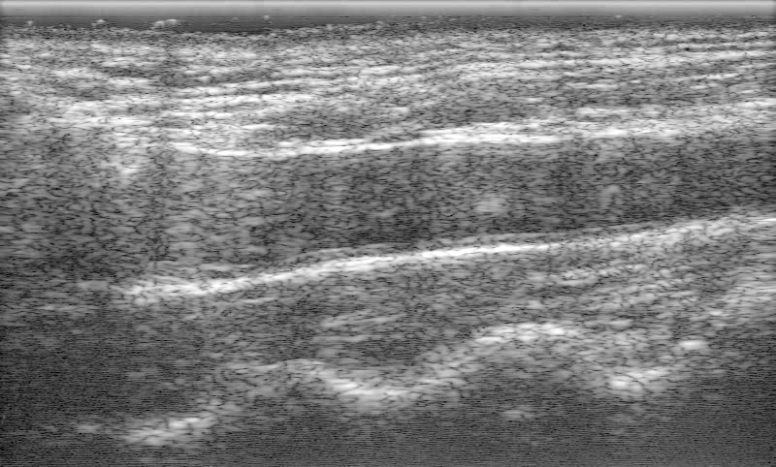
Strain imaging algorithm Bayesian regularization example: Removal of a reverberation
Displacement Images
Strain Images
Carotid artery
Cardiac Cycle Accumulation
Strain Metrics
Notes:
25

Slide 26
Strain imaging algorithm Bayesian regularization example: Removal of a reverberation
Displacement Images
Strain Images
Search Region
Cardiac Cycle Accumulation
Strain Metrics
Notes:
26

Slide 27
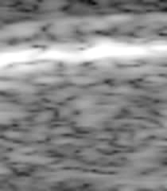
Strain imaging algorithm Bayesian regularization example: Removal of a reverberation
Displacement Images
Strain Images
Reverberation moving in the opposite direction of surrounding tissue
Cardiac Cycle Accumulation
Strain Metrics
Notes:
27

Slide 28
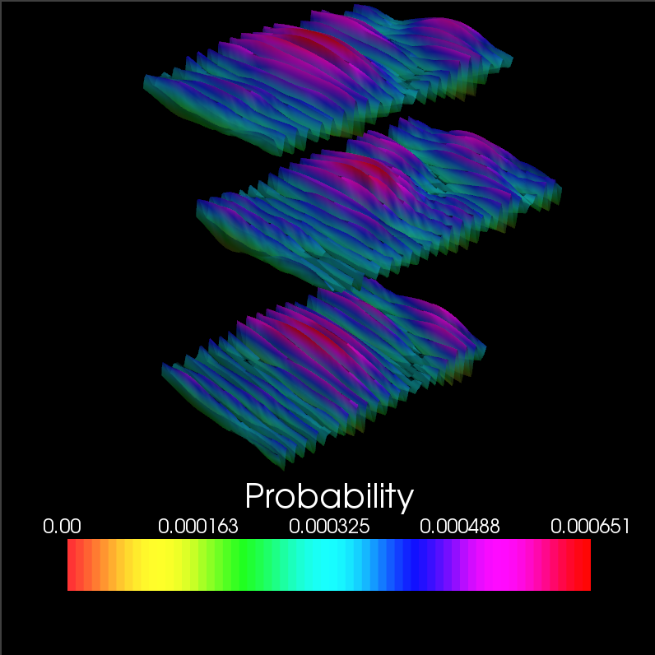
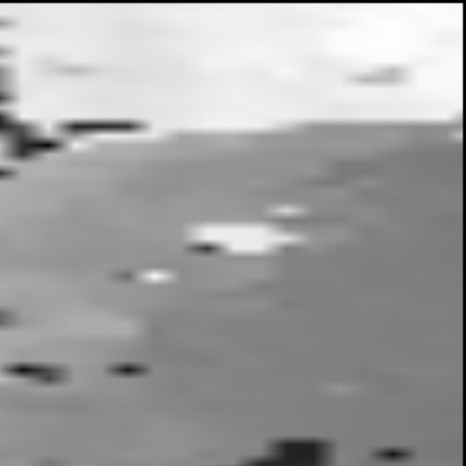
Strain imaging algorithm Bayesian regularization example: Removal of a reverberation
Regularization iteration 0
Block of interest
Lateral neighbor
Axial neighbor
Axial Displacement
Displacement Images
Strain Images
Cardiac Cycle Accumulation
B-Mode
Strain Metrics
Notes:
28

Slide 29
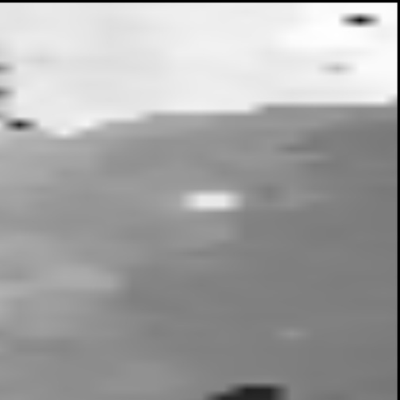
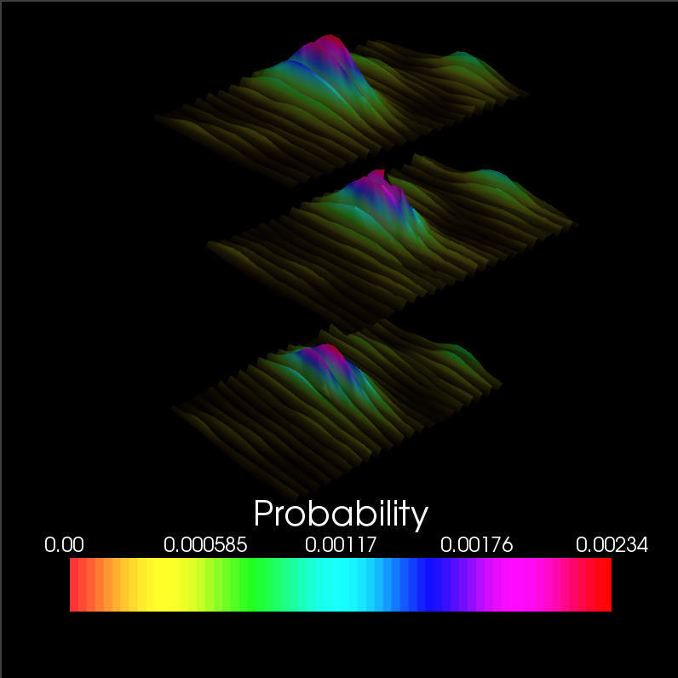
Strain imaging algorithm Bayesian regularization example: Removal of a reverberation
Regularization iteration 1
Block of interest
Lateral neighbor
Axial neighbor
Axial Displacement
Displacement Images
Strain Images
Cardiac Cycle Accumulation
B-Mode
Strain Metrics
Notes:
29

Slide 30
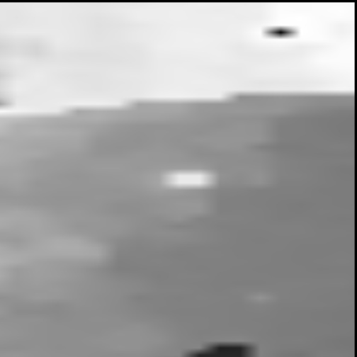
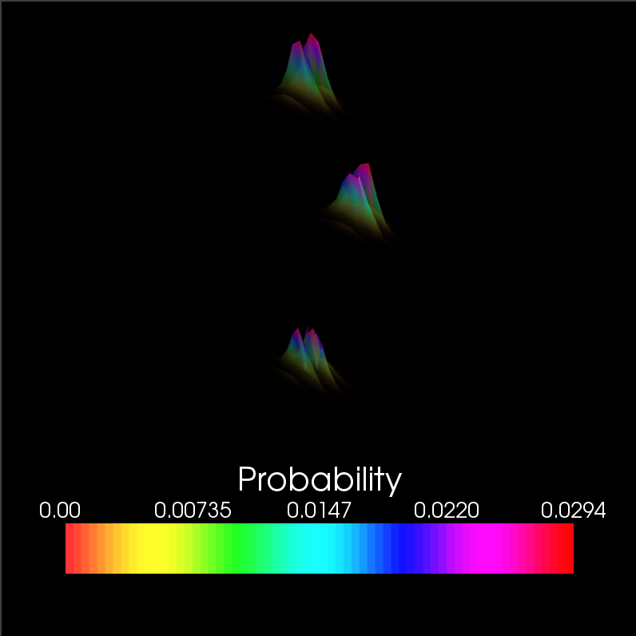
Strain imaging algorithm Bayesian regularization example: Removal of a reverberation
Regularization iteration 2
Block of interest
Lateral neighbor
Axial neighbor
Axial Displacement
Displacement Images
Strain Images
Cardiac Cycle Accumulation
B-Mode
Strain Metrics
Notes:
30

Slide 31
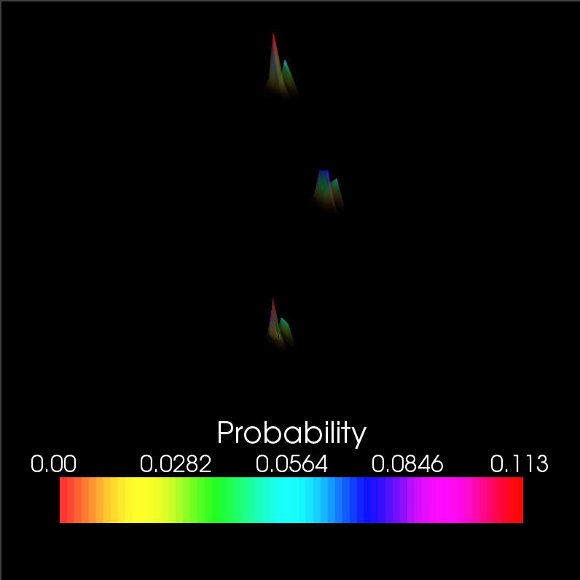
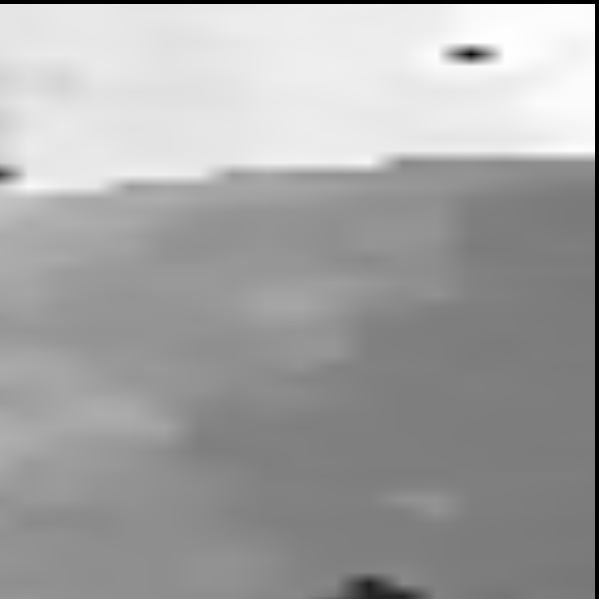
Strain imaging algorithm Bayesian regularization example: Removal of a reverberation
Regularization iteration 3
Block of interest
Lateral neighbor
Axial neighbor
Axial Displacement
Displacement Images
Strain Images
Cardiac Cycle Accumulation
B-Mode
Strain Metrics
Notes:
31

Slide 32
Strain imaging algorithm Multi-level motion tracking
Scale-space representation of RF-images
Filter by 2D Gaussian
Subsample
Use low-resolution tracked displacements to initialize higher resolution motion-tracking
Displacement Images
Strain Images
Cardiac Cycle Accumulation
Strain Metrics
Notes:
32

Slide 33
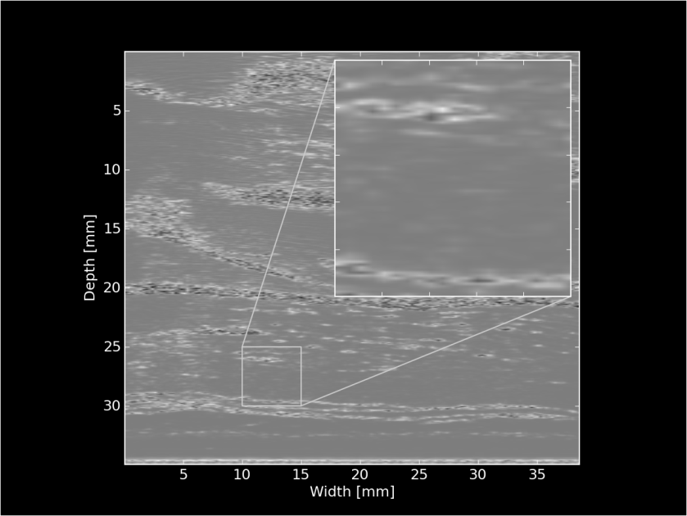
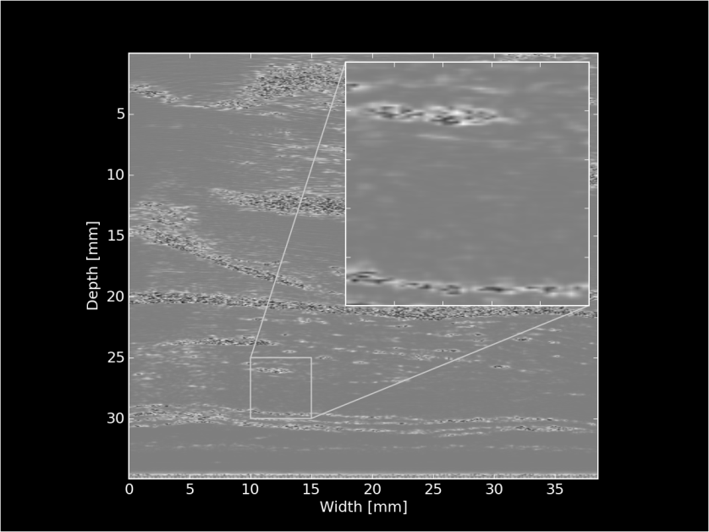
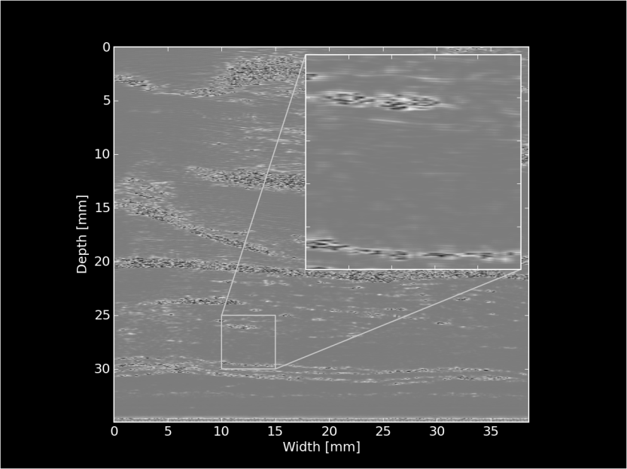
Strain imaging algorithm Multi-level motion tracking
Displacements
initialize search
Displacements
initialize search
Xxbyxx pixels
Xxbyxx pixels
Xxbyxx pixels
Displacement Images
Strain Images
Cardiac Cycle Accumulation
Strain Metrics
Notes:
33

Slide 34
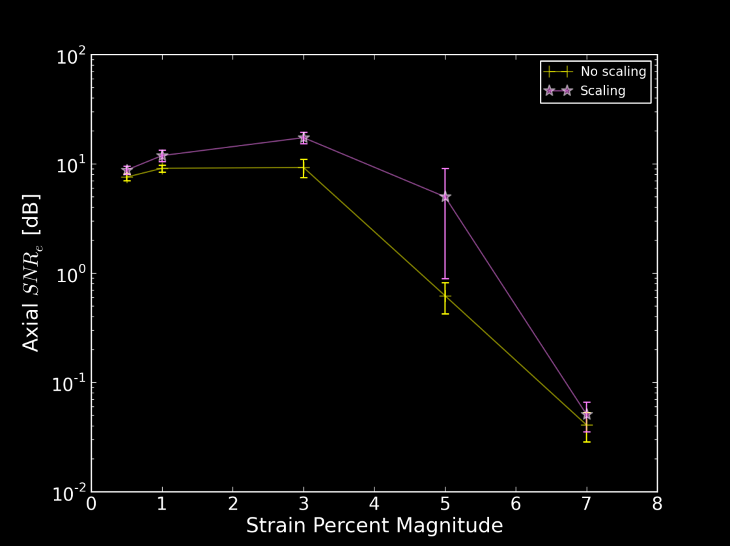
Strain imaging algorithm Multi-level motion tracking
Why?
Robustness
Avoid local minima (“peak-hopping”) in the similarity metric
Speed
Smaller search regions in higher resolution images
Stretch matching-block by prior strain results
Improve correlation
Displacement Images
Strain Images
Cardiac Cycle Accumulation
Strain Metrics
Notes:
34

Slide 35
Strain imaging algorithm Multi-level motion tracking
Displacements
initialize search
Displacements
initialize search
Xxbyxx pixels
Xxbyxx pixels
Xxbyxx pixels
Displacement Images
Strain Images
Displacement subsample
interpolation
Strain images?
Cardiac Cycle Accumulation
Strain Metrics
Notes:
35

Slide 36
Strain imaging algorithm Subsample interpolation
Objective: interpolate the similarity metric function to find subsample displacement of the matching block
Displacement Images
Strain Images
Cardiac Cycle Accumulation
Strain Metrics
Notes:
36

Slide 37
Strain imaging algorithm Subsample interpolation
Methods:
Parabolic interpolation
Fit a parabola to three point surrounding maximum sample
2D windowed-sinc interpolation with numerical optimization
Iteratively locate the subsample peak with unbiased interpolation
Displacement Images
Strain Images
Cardiac Cycle Accumulation
Strain Metrics
Notes:
37

Slide 38
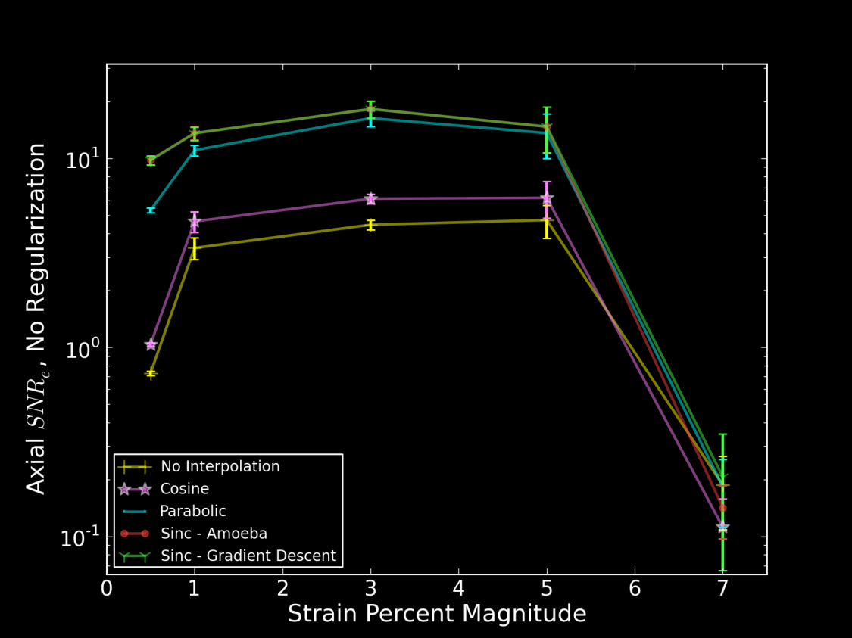
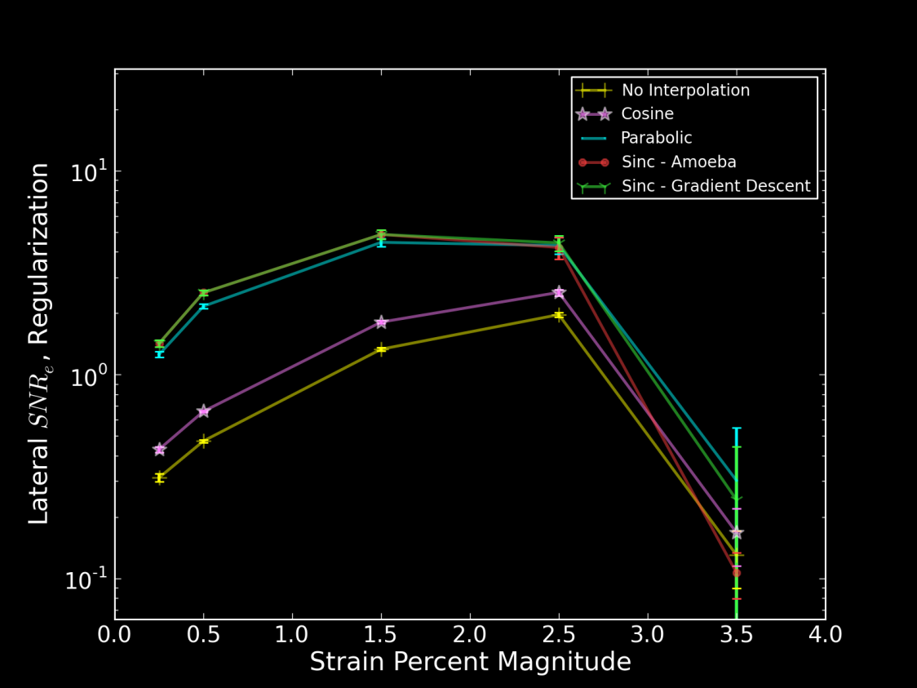
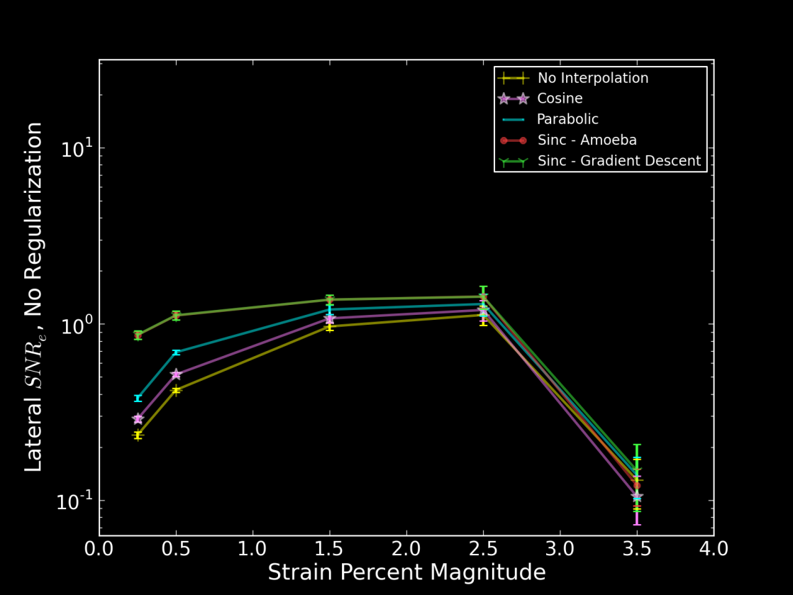
Strain imaging algorithm Subsample interpolation
Displacement Images
Strain Images
Cardiac Cycle Accumulation
Strain Metrics
Notes:
38

Slide 39
Strain imaging algorithm Strain: quantification of tissues’ mechanical distortion
Displacement Images
Strain Images
Cardiac Cycle Accumulation
Strain Metrics
Notes:
39

Slide 40
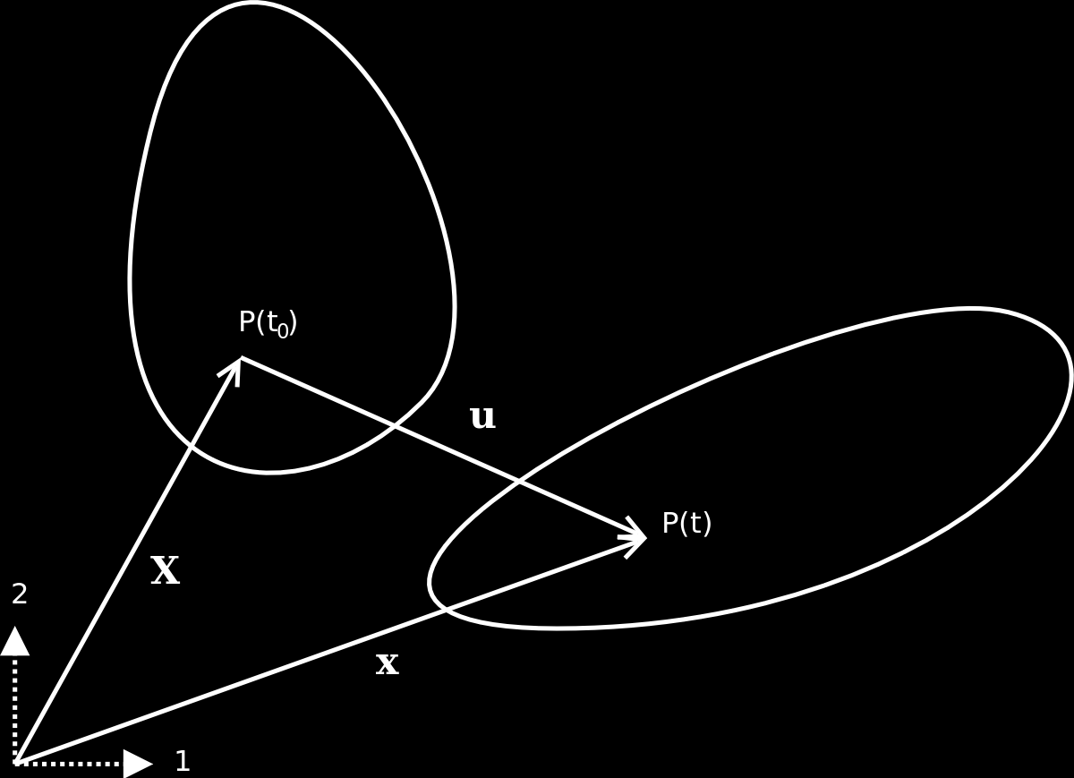
Strain imaging algorithm Strain: quantification of tissues’ mechanical distortion
Pre-deformation body
Post-deformation body
Displacement Images
Strain Images
Cardiac Cycle Accumulation
Strain Metrics
Notes:
40

Slide 41
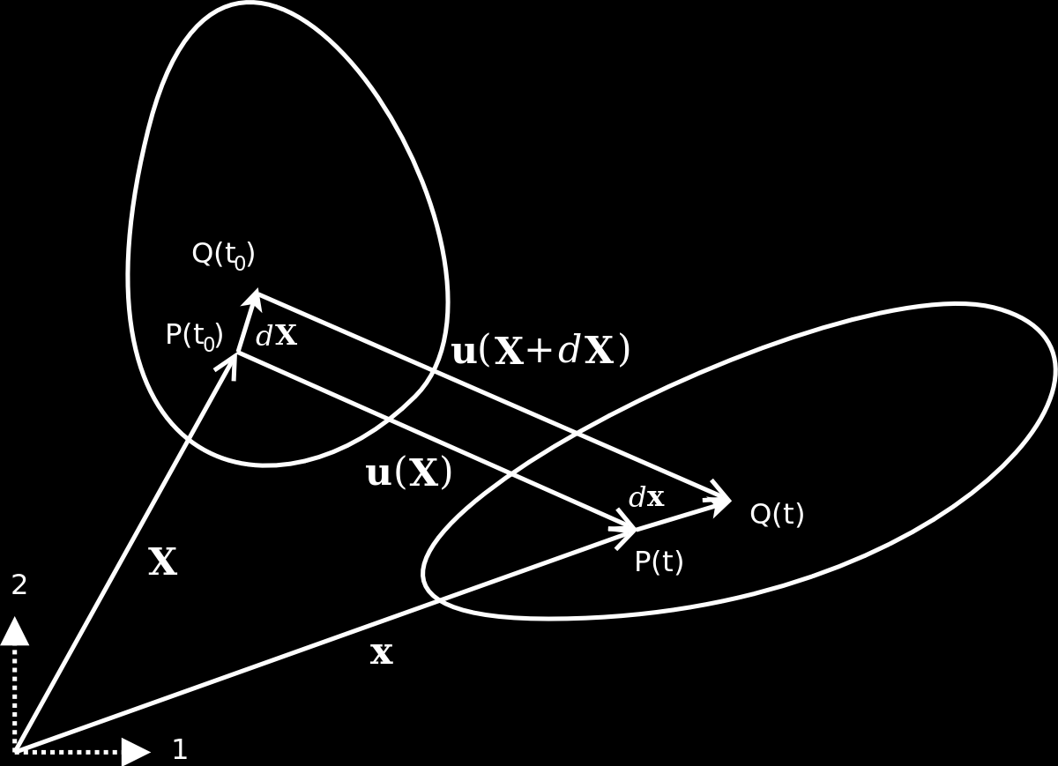
Strain imaging algorithm Strain: quantification of tissues’ mechanical distortion
Pre-deformation body
Post-deformation body
Displacement Images
Strain Images
Cardiac Cycle Accumulation
Strain Metrics
Notes:
41

Slide 42

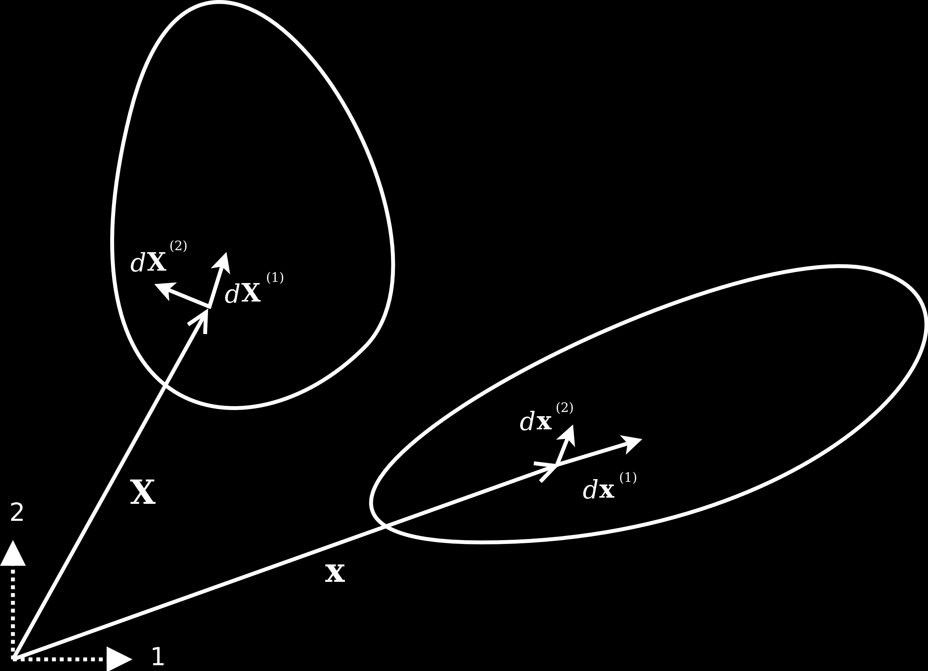



Strain imaging algorithm Strain: quantification of tissues’ mechanical distortion
Pre-deformation body
Green-Lagrangian strain:
Post-deformation body
Displacement Images
Strain Images
Eulerian-Almansi strain:
Cardiac Cycle Accumulation
Strain Metrics
Notes:
42

Slide 43
Strain imaging algorithm Physical interpretation of strain
Equation Implications
Interpretation:
Change in length, change in angle of differential segments
Displacement Images
Strain Images
Cardiac Cycle Accumulation
Strain Metrics
Notes:
43

Slide 44


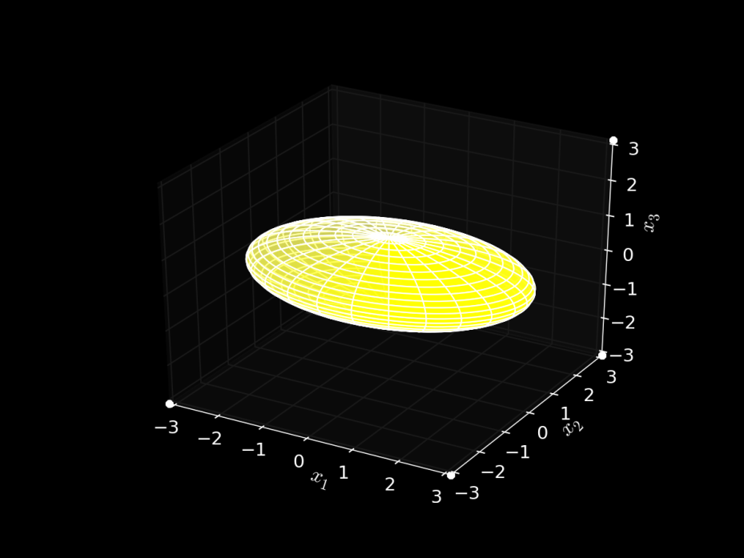
Strain imaging algorithm Ellipse representation of strain
Equation Implications
Diffusion Tensor MRI
Interpretation:
Change in length, change in angle of differential segments
Ellipse representation
Ellipsoid
Displacement Images
Strain Images
Cardiac Cycle Accumulation
Strain Metrics
Notes:
44

Slide 45
Strain imaging algorithm Ellipse representation of strain
Equation Implications
Diffusion Tensor MRI
Interpretation:
Change in length, change in angle of differential segments
Ellipse representation
Same quadric form
Real, symmetric: has Eigenvalues
Displacement Images
Strain Images
Cardiac Cycle Accumulation
Strain Metrics
Notes:
45

Slide 46
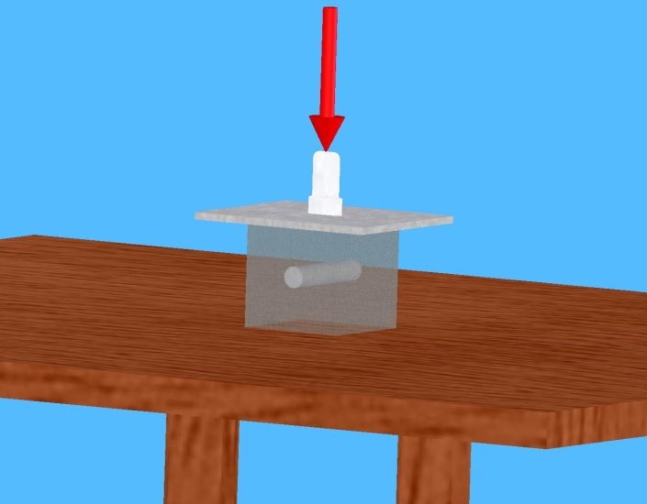
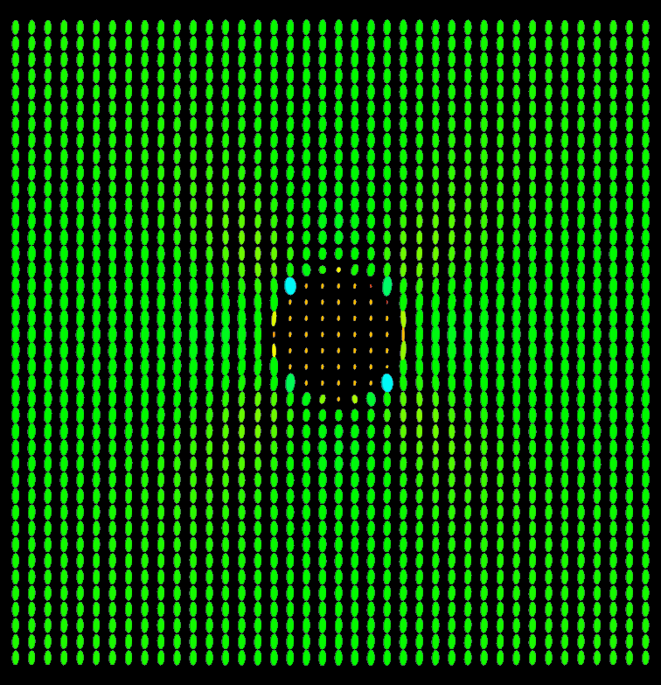
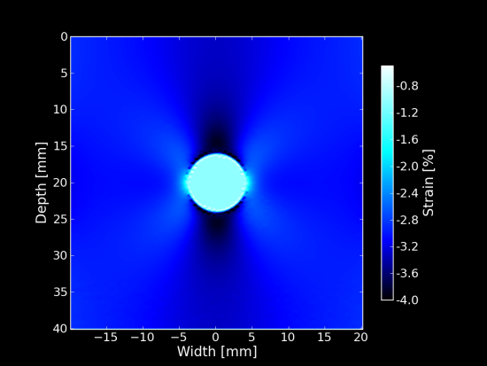
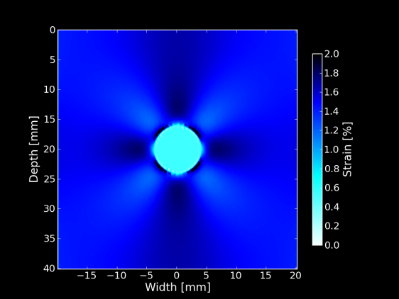
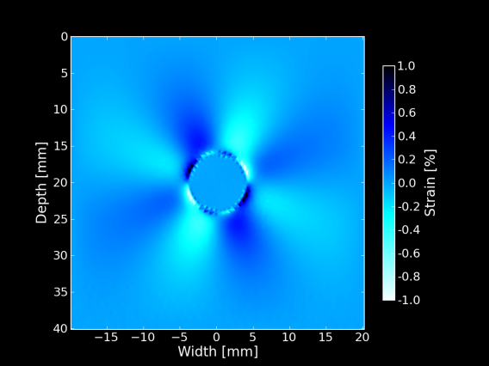
Strain imaging algorithm Ellipse representation of strain
Equation Implications
Interpretation:
Change in length, change in angle of differential segments
Ellipse representation
Displacement Images
Strain Images
Cardiac Cycle Accumulation
Strain tensor ellipses
Strain Metrics
Individual strain tensor components
Notes:
46

Slide 47

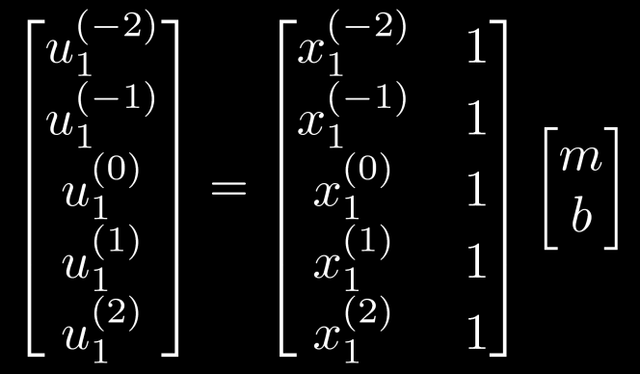

Strain imaging algorithm Displacement gradient calculation for noisy, discontinuous data
Equation Implications
Interpretation:
Change in length, change in angle of differential segments
Ellipse representation
Calculation:
Displacement gradients
Noisy
Local least-squares linear fit to estimate displacement gradients
Displacement Images
Strain Images
Cardiac Cycle Accumulation
Strain Metrics
Notes:
47

Slide 48
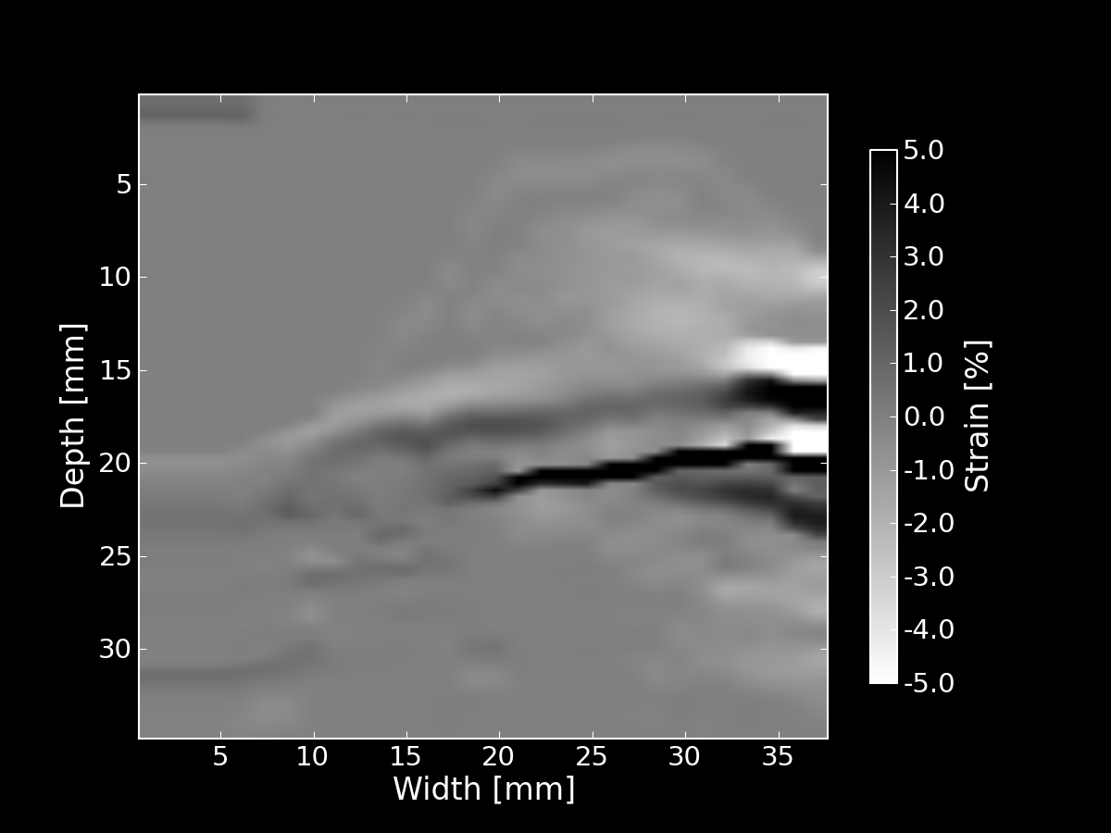
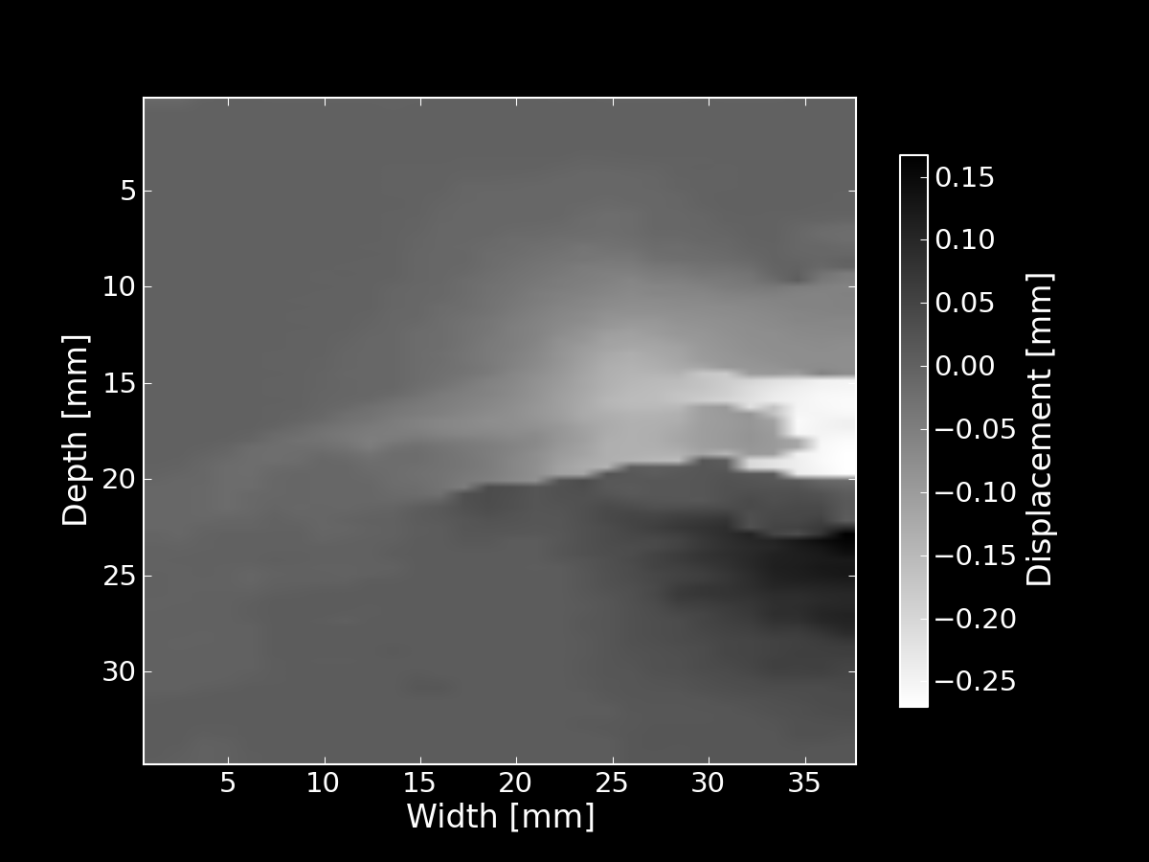
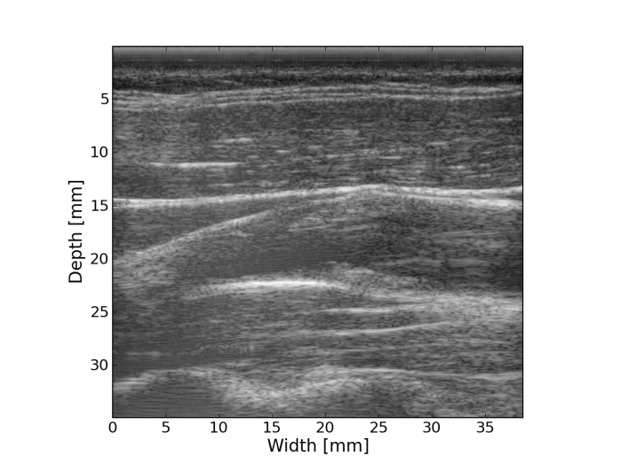
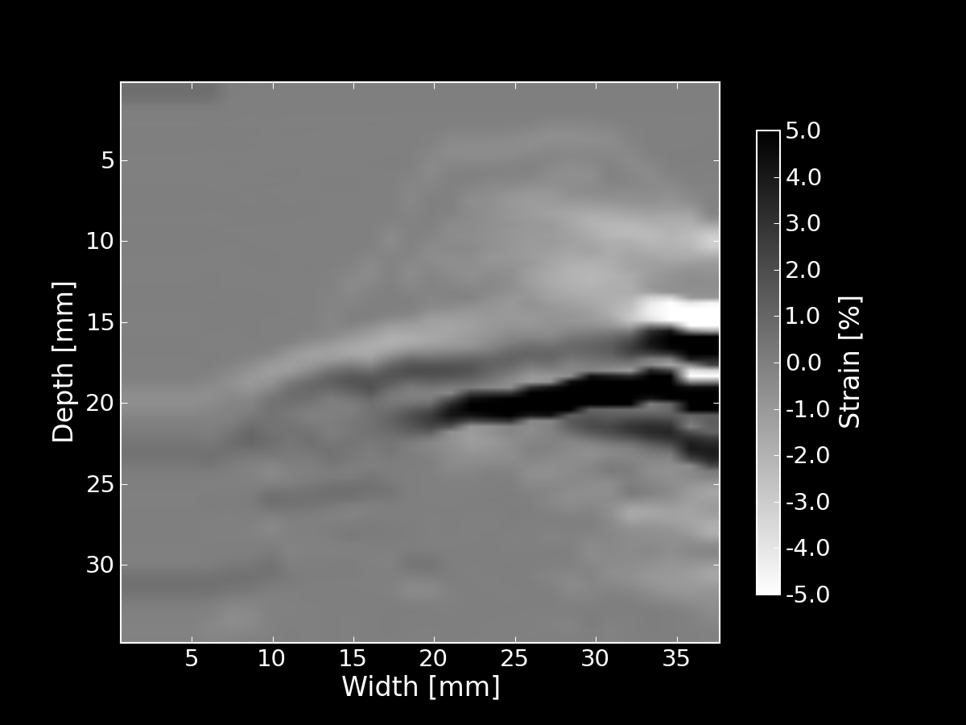
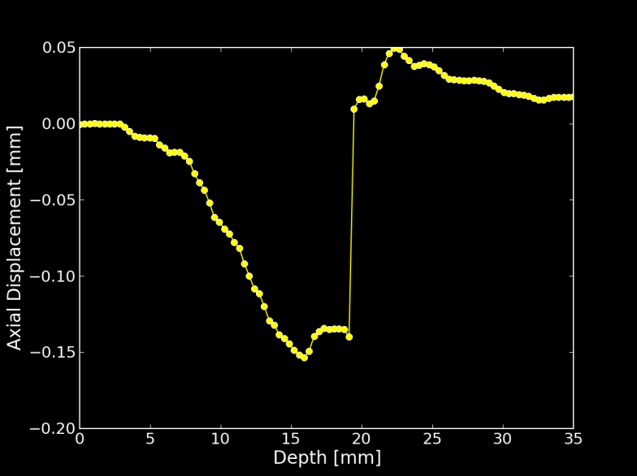
Strain imaging algorithm Displacement gradient calculation for noisy, discontinuous data
Equation Implications
Interpretation:
Change in length, change in angle of differential segments
Ellipse representation
Calculation:
Displacement gradients
Noisy
B-Mode
Axial displacement
Displacement Images
Strain Images
Cardiac Cycle Accumulation
Axial strain
Discontinuity corrected strain
Displacement along line
Strain Metrics
Notes:
48

Slide 49
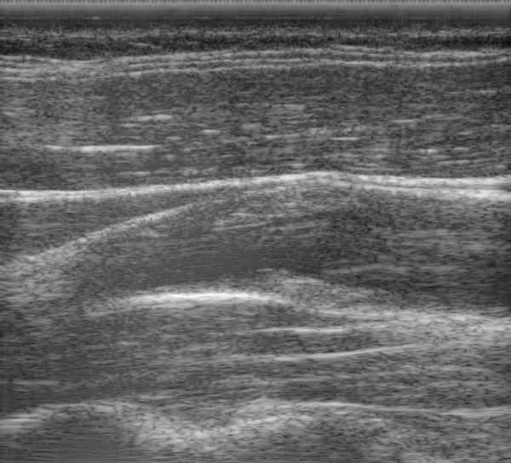


Strain imaging algorithm Strain over cardiac cycle
Pre-deformation body
Post-deformation body
Displacement Images
Strain Images
Cardiac Cycle Accumulation
Strain Metrics
Notes:
49

Slide 50


Strain imaging algorithm Accumulation of incremental Eulerian strain: particle approach
Calculate incremental displacements
Use dynamic frame skip
Right amount of motion for best motion-tracking
Accumulate incremental Eulerian strains
Diastole
Systole
Displacement Images
Strain Images
Cardiac Cycle Accumulation
Strain Metrics
Notes:
50

Slide 51
Strain imaging algorithm Accumulating strain over the cardiac cycle
The problem: tissue to accumulate over is moving
Displacements are generally not pixel multiples
The solution: accumulate on particles
Displacement Images
Strain Images
Cardiac Cycle Accumulation
Strain Metrics
Notes:
51

Slide 52


Strain imaging algorithm Accumulating strain over the cardiac cycle
B-Mode
Binary mask segmentation
Mesh segmentation
Displacement Images
Strain Images
Cardiac Cycle Accumulation
Strain Metrics
Notes:
52

Slide 53


Strain imaging algorithm Accumulating strain over the cardiac cycle
Pre-deformation
Post-deformation
Displacement Images
Strain Images
Cardiac Cycle Accumulation
Strain Metrics
Notes:
53

Slide 54

Strain imaging algorithm Accumulating strain over the cardiac cycle
Displacement Images
Strain Images
Cardiac Cycle Accumulation
Strain Metrics
Notes:
54

Slide 55




Strain imaging algorithm Tensor to scalar: yield criteria
Maximum principal strain
Maximum shear strain
Total strain energy
Displacement Images
Strain Images
Distortional energy
Cardiac Cycle Accumulation
Strain Metrics
Notes:
55

Slide 56
Strain imaging algorithm Scalar over cardiac cycle to single value
Peak-to-peak mean
Peak-to-peak 90th percentile
Peak-to-peak variance
All three of the above for the sum of the magnitude of the time derivative
Displacement Images
Strain Images
Cardiac Cycle Accumulation
Strain Metrics
Notes:
56

Slide 57
Non-invasive in vivo strain imaging Imaging plaque mechanics
Notes:
57

Slide 58
Non-invasive in vivo strain imaging Influence of morphology
Displacement vectors
Notes:
58

Slide 59



Non-invasive in vivo strain imaging Influence of morphology
Notes:
59

Slide 60

Non-invasive in vivo strain imaging Influence of morphology
Strain tensor ellipse
Notes:
60

Slide 61
Factors that increase risk
Increased hemodynamic forces
Hypertension
Cyclic loading
Stress concentrators
Material inhomogeneity
Morphological irregularity
Ulceration
Vasa vasorum
Weak materials
Inflammation and enzymes such as matrix metalloproteinase-9.
Weak constituents such as lipid or fresh hemorrhage.

Slide 62




Non-invasive in vivo strain imaging Influence of morphology
Notes:
62

Slide 63
Non-invasive in vivo strain imaging Influence of hemodynamics
Notes:
63

Slide 64
Factors that increase risk
Increased hemodynamic forces
Hypertension
Cyclic loading
Stress concentrators
Material inhomogeneity
Morphological irregularity
Ulceration
Vasa vasorum
Weak materials
Inflammation and enzymes such as matrix metalloproteinase-9.
Weak constituents such as lipid or fresh hemorrhage.

Slide 65

Non-invasive in vivo strain imaging Influence of hemodynamics
Strain tensor ellipse
Notes:
65

Slide 66

Non-invasive in vivo strain imaging Influence of hemodynamics
Notes:
66

Slide 67


Non-invasive in vivo strain imaging Influence of composition
Notes:
67

Slide 68
Factors that increase risk
Increased hemodynamic forces
Hypertension
Cyclic loading
Stress concentrators
Material inhomogeneity
Morphological irregularity
Ulceration
Vasa vasorum
Weak materials
Inflammation and enzymes such as matrix metalloproteinase-9.
Weak constituents such as lipid or fresh hemorrhage.

Slide 69

Non-invasive in vivo strain imaging Influence of composition
Displacement vectors
Notes:
69

Slide 70

Non-invasive in vivo strain imaging Influence of composition
Strain tensor ellipse
Notes:
70

Slide 71

Non-invasive in vivo strain imaging Influence of composition
Notes:
71

Slide 72


Non-invasive in vivo strain imaging High wall shear
Displacement vectors
Notes:
72

Slide 73
Factors that increase risk
Increased hemodynamic forces
Hypertension
Cyclic loading
Stress concentrators
Material inhomogeneity
Morphological irregularity
Ulceration
Vasa vasorum
Weak materials
Inflammation and enzymes such as matrix metalloproteinase-9.
Weak constituents such as lipid or fresh hemorrhage.

Slide 74


Non-invasive in vivo strain imaging High wall shear
Strain tensors
Notes:
74

Slide 75


Non-invasive in vivo strain imaging High wall shear
Notes:
75

Slide 76

Non-invasive in vivo strain imaging Complex plaque with calcification
Displacement vectors
Notes:
76

Slide 77
Factors that increase risk
Increased hemodynamic forces
Hypertension
Cyclic loading
Stress concentrators
Material inhomogeneity
Morphological irregularity
Ulceration
Vasa vasorum
Weak materials
Inflammation and enzymes such as matrix metalloproteinase-9.
Weak constituents such as lipid or fresh hemorrhage.

Slide 78

Non-invasive in vivo strain imaging Complex plaque with calcification
Strain tensor ellipses
Notes:
78

Slide 79

Non-invasive in vivo strain imaging Complex plaque with calcification
Notes:
79

Slide 80
High frequency US characterization Overview
High frequency = high resolution
3D
Quantitative ultrasound imaging
Remove system effects
Use reference phantom with known acoustic properties to normal out imaging system properties
Notes:
80

Slide 81

High frequency US characterization Reference phantom characterization
Notes:
81

Slide 82


High frequency US characterization Reference phantom characterization
High frequency challenges
High signal attenuation
Increased precision required
Non-linear propagation
Notes:
82

Slide 83

High frequency US characterization Speed of sound
Notes:
83

Slide 84

High frequency US characterization Attenuation
Notes:
84

Slide 85

High frequency US characterization Absolute backscatter coefficient
Notes:
85

Slide 86


High frequency US characterization Plaque characterization
Notes:
86

Slide 87


High frequency US characterization High risk plaque
Large plaque with excessive amount of thrombus and signs of inflammation on removal.
Ulcerated, complex morphology of the inner wall with soft, weak plaque and little calcification.
Likely unstable with recent rupture events.

Slide 88

High frequency US characterization Plaque characterization
Notes:
88

Slide 89

High frequency US characterization Plaque characterization
Notes:
89

Slide 90

High frequency US characterization Plaque characterization
Notes:
90

Slide 91


High frequency US characterization Low risk plaque
Long plaque composed primarily of fibrous tissue with dispersed calcified areas.
Smooth, regular inner wall.
Likely stable.

Slide 92

High frequency US characterization Plaque characterization
Notes:
92

Slide 93

High frequency US characterization Plaque characterization
Notes:
93

Slide 94

Transcranial Doppler Anatomy
Wish to validate the presence of microemboli in vivo to associate with plaque risk.
Cannot be detected in carotid ultrasound because of resolution and coverage issues.
Transcranial Doppler monitoring of middle cerebral artery.

Slide 95
Transcranial Doppler Methods
Collect continuous velocity data for 1 hour immediately following carotid ultrasound.
Reviewed by three trained observers.
High Intensity Transient Signals (HITS) count >= 1/hour associated with increased stroke risk.
Notes:
95

Slide 96


Transcranial Doppler Data review
Velocity
Time

Slide 97



Where have we come from? Guy Cloutier’s October 2010 assessment
Snowbird 2006
Snowbird 2010

Slide 98



Where have we come from? Guy Cloutier’s October 2010 assessment
Unsolved problems?
1. Investigate operator dependence
2. Increase algorithm robustness
3. New criteria of vulnerability

Slide 99

Where are we going? Future work
Process available patient data
Improve high-frequency data utilization and image quality
Improved attenuation estimation
Segment and register with histology
New TCD machine

Slide 100
Acknowledgements
Committee members
- Dr. Robert Dempsey
- Dr. Timothy Hall
- Dr. Mark Kliewer
- Dr. Elizabeth Meyerand
- Dr. Tom Yin
- Dr. Tomy Varghese
- Dr. James Zagzebski
Phantom Experts
- Dr. Ernest Madsen
- Gary Frank
- Meagan Deaner
Ultrasonographers
- Dr. Carol Mitchell
- Sara Baker
- Bridgett Finnegan
Visualsonics
- Dr. Tim Hacker
- Dr. Tim Stiles
Research coordination
- Pam Winne
- Cindy Colombo
- Niki Virnig
Pathology
- Dr. Shahriar Salamat
Condor
- Dr. Orhan Unal
- Xiaohu Mo
- Dr. Michael Kissick
- Bill Taylor
- Yacouba Traore
UW-THW
- Dr. Nicholas Preston
- Dr. Paul Wilson
- Dr. Milad Fatenejad
- Dr. Matthew Terry
- Anthony Scopatz
- Katy Huff
- Rachel Slaybough
- Aronne Merrelli
- Royal Elmore
…
Dept. Administrators
- JoAnn Kronberg
- Beth Bierman
- Anne Duchek
Ultrasound group members
- Dr. Hairong Shi
- Dr. Maritza Hobson
- Dr. Jingfeng Jiang
- Dr. Miklos Kiss
- Dr. Ted Fisher
- Dr. Dave Duncan
- Xiao Wang
- Kibo Nam
- Ryan DeWall
- Nick Rubert
- Matthew Bayer
- Haiyan Xu
- Eenas Omari
- Lisa Reusch
- Chi Ma
- Wenqi Ge
- Kayvan Samimi
- Eric Nordberg
- Dr. Jihad Al-Sadah
- Ivan Rosado-Mendez
- Lindsey Carlson
- Janelle Anderson
- Theo Pavan
Medical Physics Graduate Students, Faculty, and Scientists
Roommates
- Michael Tomkowiak
- Matthew Nyflot
- Armando Ibarra
Family
- Parents, Dr. Michael and Bernadette McCormick
- Siblings, Erin, Paul, Ryan, Rebecca, Sean
- Uncle, Patrick and Sara McCormick, and cousins
5-Hour Energy

Slide 101
Related Pathologies: Different intensities and time courses
Transient ischemic attacks (TIA) are cerebral impairment that subside in under 24 hours, which often precede a stroke.
Recent evidence has correlated microemboli that may cause chronic ischemic burden with dementia in Alzheimer’s.
A correlation has also been observed between migraine and ischemic stroke.

Slide 102
Current methods for assessing Risk
Currently, stenosis >70% qualifies a patient for endarterectomy.
With this assessment method, only 16% of patients that have a carotid endarterectomy benefit from surgery¹.
¹P.M. Rothwell and C.P Warlow. Prediction of benefit from carotid endarterectomy in individual patients: a risk-modeling study. European Carotid Surgery Trials’ collaborative group. Lancet, 353 (9170): 2105-2110, Jun 1999.

Slide 103
Methods being investigated to assess Risk
Image plaque composition.
Ultrasound
MRI
Image markers of inflammation.
PET
Catheter based methods
Image ulceration or vasa vasorum.
Angiography
Ultrasound
MRI

Slide 104

Non-invasive in vivo strain imaging Influence of composition
Notes:
104

Slide 105

High frequency US characterization Visualsonics user interface

Slide 106
High frequency US characterization Requirements
There have been previous efforts to create integrated backscatter images, but all used the planar reflector method.
We propose the use of the reference phantom method, but it requires a stable, well characterized reference phantom with acoustic properties similar to plaque.
We have to quantify
Attenuation
Alignment, play, small spaces
Signal attenuation and sampling rate
Water attenuation and Saran transmission coefficient
Absolute backscatter coefficient
Attenuation and alignment
Measure transducer effective aperture and focus

Slide 107
High frequency US characterization Integrated backscatter coefficient
Create images of the integrated backscatter coefficient.
The backscatter coefficient is backscattered power per solid angle per volume per incident intensity of a plane wave
Varies with frequency Integrate
Quantity that reflects material properties
Effective scatterer size
Acoustic impedance gradient
Scatterer density
Notes:
107

Slide 108


Transcranial Doppler HITS
Microemboli indicated by high intensity transient signal (HITS)
Lasts < 300 ms
Intensity at least 3dB higher than background
Unidirectional in velocity
Unilateral
Audible ‘snap’, ‘chirp’, or ‘moan’

